Slide 1
Text Analytics Convolutional Neural Networks + Word Embedding
Azure Machine Learning Meetup
August 16, 2018

Slide 2
agenda
Quick summary of earlier sessions on text analytics
Introduction and basic of convolutional neural networks (CNN)
How a CNN can be applied to text based content
What can be learned this way that is different from our prior models
What can we built on top of a CNN

Slide 3
Recap of prior sessions and this session
1- basics of sentence structure, word standardization, cleansing etc
2 – basic statistics around words – features, bag of words, TFIDF
3 – basics of topics (LDA,LSA) – move from pure stats to some content
4 – last time (late June):
Words in context
Creating vectors to map words and their ‘neighbors’ to provide context and occurrence patterns
Word2vec, genism – sample code
Tonight – August 16:
CNN Intro and Concepts
CNN and word embedding
Intro to RNN for Sequencing Analysis

Slide 4
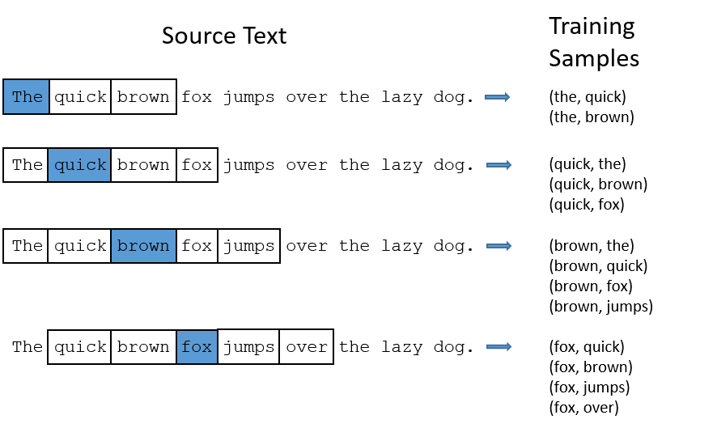
Look back: Representing “near” and “neighbor” words
http://mccormickml.com/2016/04/19/word2vec-tutorial-the-skip-gram-model/

Slide 5
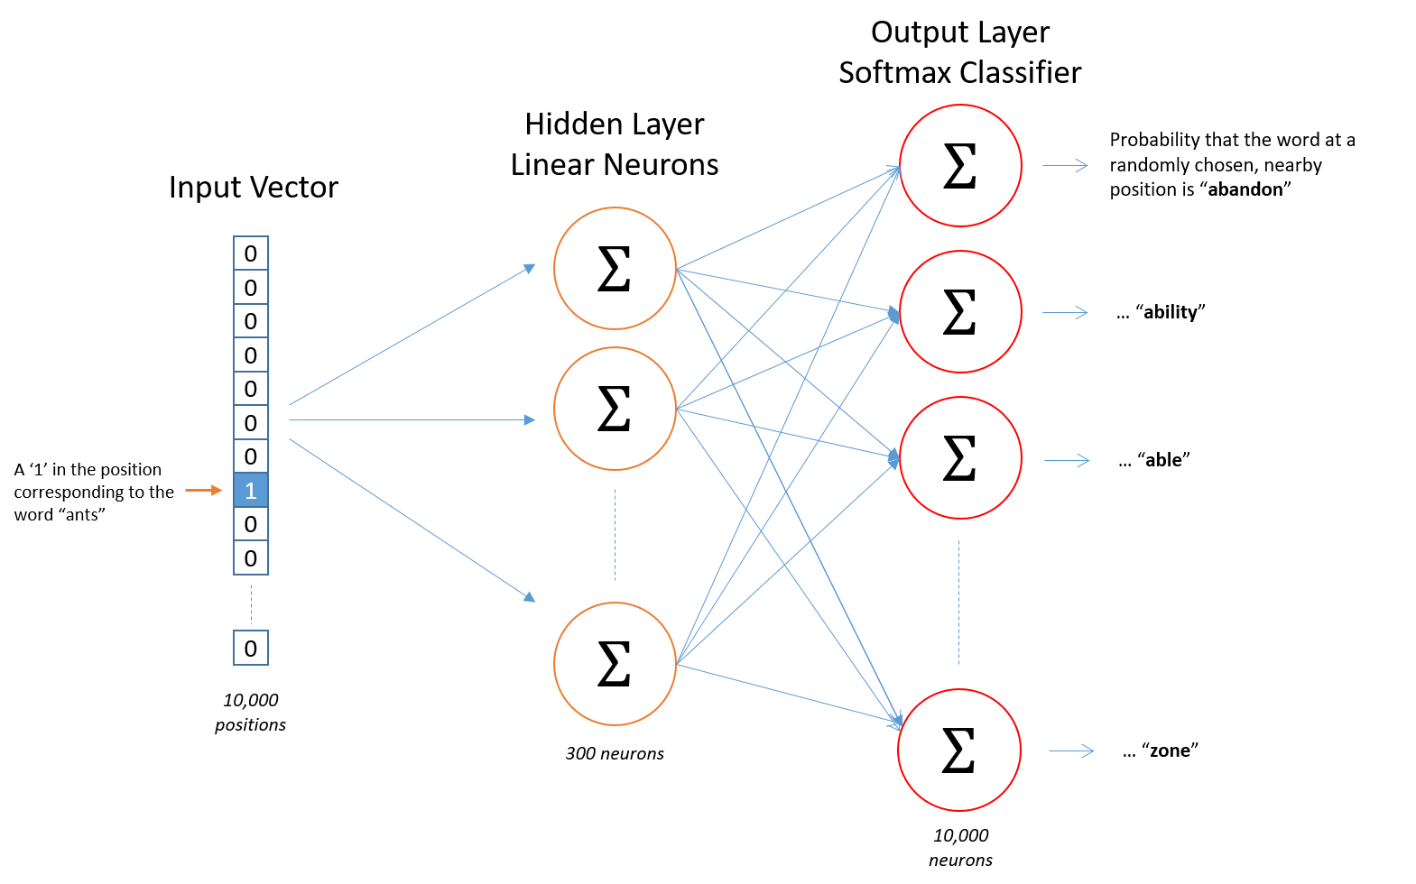
Look Back: Vector mapping concepts
Input is one hot encodings of our tokens (words in a corpus)
Hidden Layer applies weights based on learning the distribution of the one hot encodings (i.e. the distribution and co-occurrence of words)
Learns via standard NN back propagation
At the end – the hidden layer acts like a lookup function for an input

Slide 6
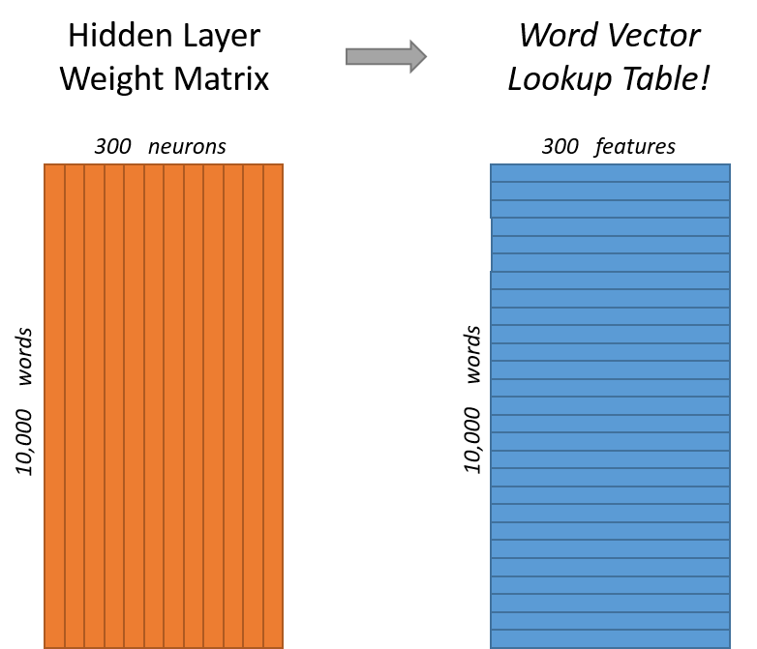
Look Back

Slide 7
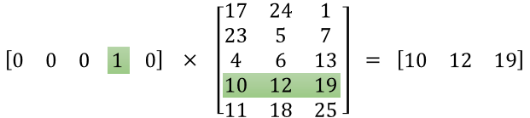
Notice how this is essentially an lookup
http://mccormickml.com/2016/04/19/word2vec-tutorial-the-skip-gram-model/

Slide 8
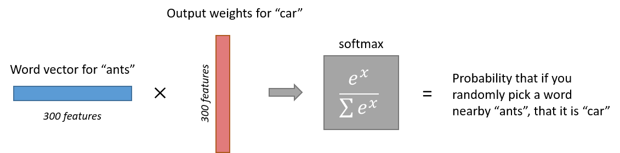
Look Back Output layer
Note that neural network does not know anything about the offset of the output word relative to the input word. It does not learn a different set of probabilities for the word before the input versus the word after.
To understand the implication, let's say that in our training corpus, every single occurrence of the word 'York' is preceded by the word 'New'. That is, at least according to the training data, there is a 100% probability that 'New' will be in the vicinity of 'York'. However, if we take the 10 words in the vicinity of 'York' and randomly pick one of them, the probability of it being 'New' is not 100%; you may have picked one of the other words in the vicinity.

Slide 9
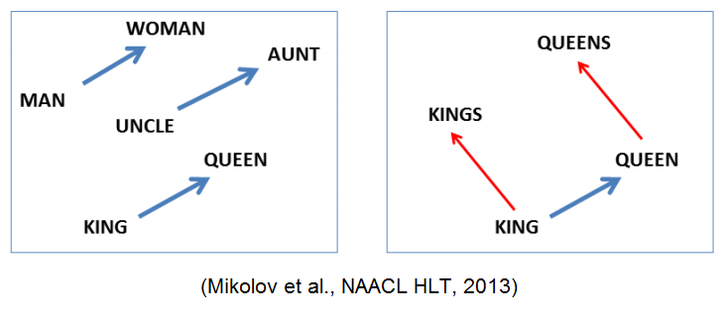
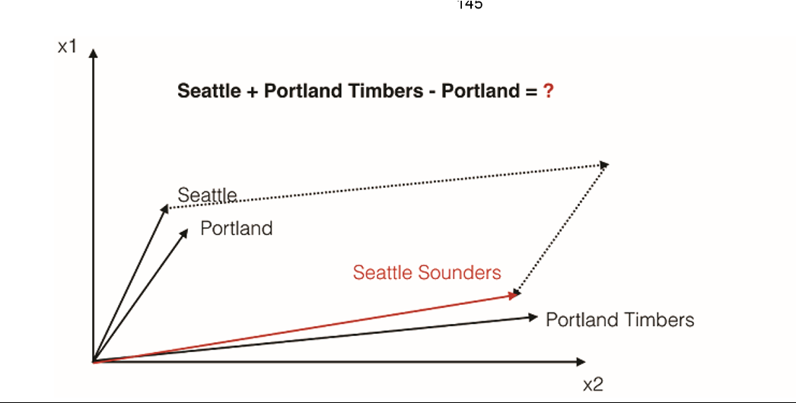
Look Back Words and vectors
From “Natural Language Processing in Action”, by Lane, Howard, Hapke from Manning Press.

Slide 10
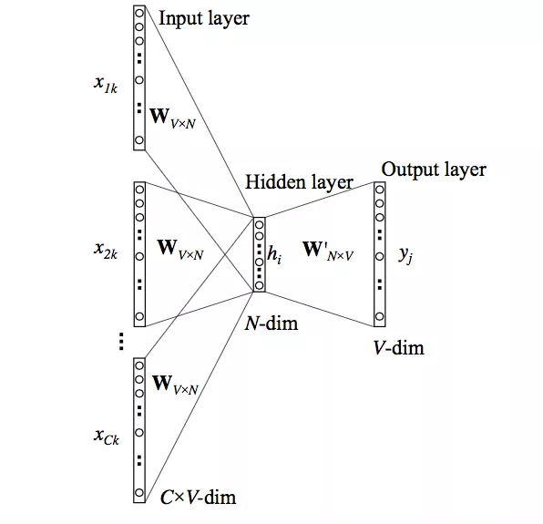
Look Back Continuous bag of words approach multiple context words as input

Slide 11
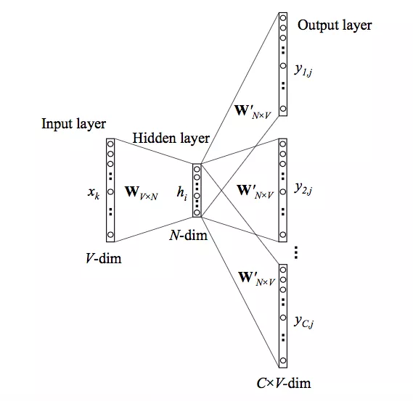
Look Back Skip Gram Approach one input word multiple output words

Slide 12
Compare CBOW and Skip Gram "watch movies rather than read books"
Training instances for CBOW (assume size of 2) would look like :
Input : [("watch", "rather", "than)], Output : [("movies")]
Input : [("watch", "movies", "than", "read")], Output : [("rather")]
if the input is [("watch", "movies", "than", "read")],
then desired output would be [("rather")]
Skip Gram architecture, if the input is [("rather")]
then the desired output would be
[("watch", "movies", "than", "read")].

Slide 13
Code flow to make your own model
Obtain and prepare a text corpus using nltk or similar
tokens = nltk.wordpunct_tokenize(doc) #usually in a loop or list comp
corpastokens = [token.lower() for token in tokens……]
Create a word2vec instance model passing in the corpus as a list of lists of tokenized sentences
import gensim
from gensim.models.keyedvectors import KeyedVectors
from gensim.models.word2vec import Word2Vec
model = Word2Vec( corpastokens,workers=num_workers,size=num_features, min_count=min_word_count,window=window_size,
sample=subsampling,hs=1,sg=skorcb)
Explore
model.wv[‘aword’]
Let’s go through a sample
Full source posted to https://github.com/jimwill3/NY-AZML-Meetup

Slide 14
Forward: Let’s apply Convolutional Neural Nets to text

Slide 15
Why are CNNs useful
They are computationally efficient
More so than a fully connected neural network
They are effective
And often excel and images, sequences, time series
They are flexible
Ongoing improvements by combining CNN with other techniques
The tolerate noise (to some degree) in the data

Slide 16
What’s a Convolutional neural network? (extracted from Wikipedia)
A CNN architecture is formed by a stack of distinct layers that transform the input volume into an output volume (e.g. holding the class scores) through a differentiable function.
The layer's parameters consist of a set of learnable filters (or kernels), which have a small receptive field
As a result, the network learns filters that activate when it detects some specific type of feature at some spatial position in the input.

Slide 17
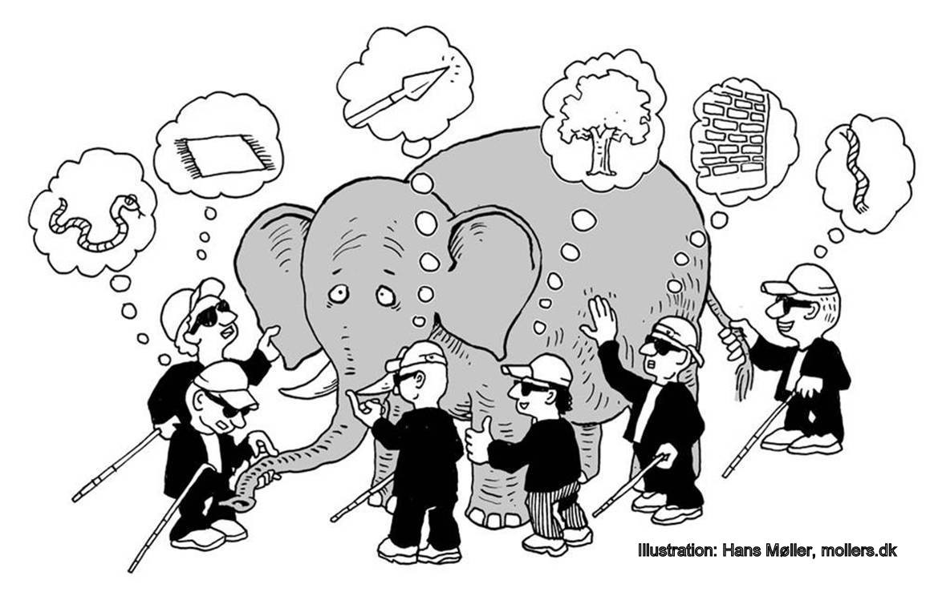
Layers and Filters – how does this work
https://medium.com/impactai/cnns-from-different-viewpoints-fab7f52d159c

Slide 18
Rationale and Purpose of a CNN
Learn in layers or filters
Each layer or filter is very good at a single or small set of capabilities
Detect edges, distinguish vertical from horizontal
Original model idea based on eyesight behavior which also has layers/filters of sub-specialty
CNNs are purpose built to form a set of filters that reduce the error in correctly detecting visual outputs
This also permits some transfer learning – reuse a trained CNN without having to start from scratch
CNN also can reduce some of the default computational scale of large feature sets such as those associated with images (200*200 image has 40K features and associated connections and weights in a basic neural net
These principles apply to text data too as they form natural sequences
Note: if randomly shuffling data does not change the meaning of the features – a CNN may not be the best fit

Slide 19



Image + a Filter(layer) --> Output

Slide 20
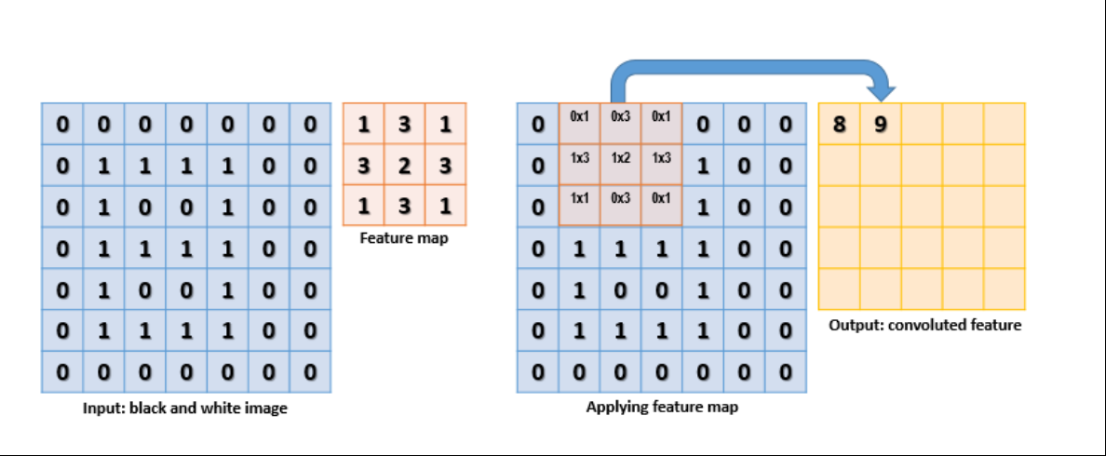
High level feature map
A feature map is basically a sliding window over sub-regions of the layer's inputs, where each application of the map results in one dimension of the output activation vectorhttps://gallery.cortanaintelligence.com/Tutorial/Cognitive-Toolkit-MNIST-CNN-OCR

Slide 21
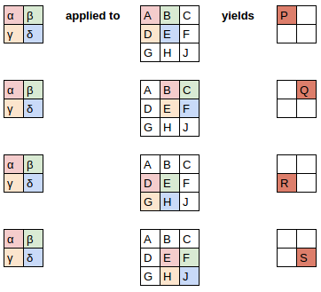
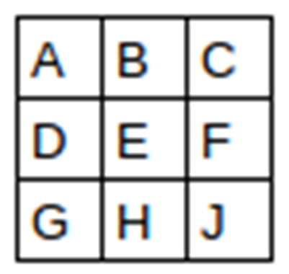
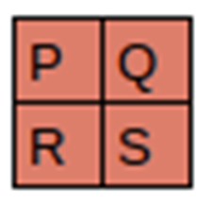
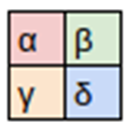
Overall flow Filter applied to input grid this is one filter/layer (2*2) over a (3*3) input grid

Slide 22
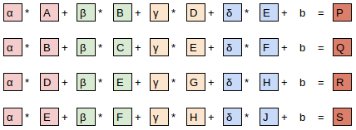
Notice that bias b is the same for all
Thanks to: https://medium.com/impactai/cnns-from-different-viewpoints-fab7f52d159c

Slide 23
Max pooling
Pooling is a technique to consolidate outputs from feature maps
Helps to provide some guards against hard-wired filters – for example, digits may not always be written at the same exact angle and aspect and pooling provides some flexibility and support invariance
Common to have a feature/pool/feature/pool architecture
"Max Pooling" is an operation placed after the activation function that aims at reducing dimensionality. It divides the input into a set of non-overlapping regions, where for each region it outputs the maximum activation value (independently for each depth slice)

Slide 24
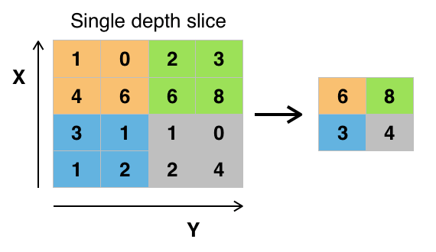
Max Pooling at work
Here is an example (from Wikipedia) of max pooling with a window size of [2 x 2] (which would reduce a hidden layer of [28 x 28 x 16] to [14 x 14 x 16]):
What this achieves is two-fold: (1) it reduces the number of parameters and thus helps controlling overfitting; and (2) it selects the salient activation values regardless of their location in the region, which helps training models that are more resilient to things like rotation / translation

Slide 25

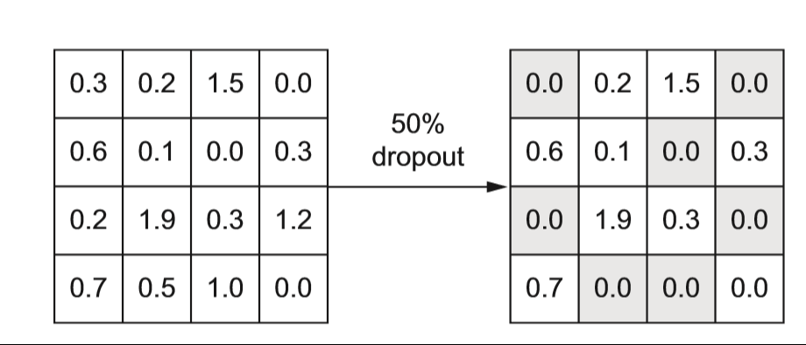
One more thing…Dropouts
Dropout is a very simple training technique that helps mitigate model overfitting
Dropout works by essentially averaging many possible models in an efficient way
A common approach is to use hidden node dropout with p = 0.2 or 0.3

Slide 26
How do we do this with text?
Text is one dimensional
Text is varying in length (images are fixed 24*24 etc.)
What does it mean to pool the weights of text based values
What kind of stride and filter size makes sense with text
What do we do with the output of the pooled layer

Slide 27
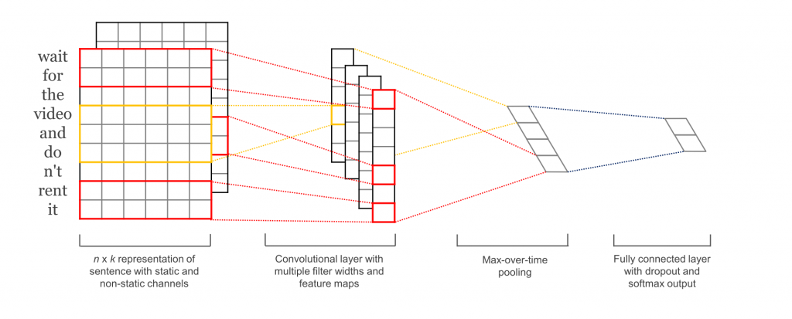
High level architecture
Taken from paper on sentence classification
Classification means final layer has ‘n’ nodes where ‘n’ is the number of classes for classification
Kim, Y. (2014). Convolutional Neural Networks for Sentence Classification

Slide 28
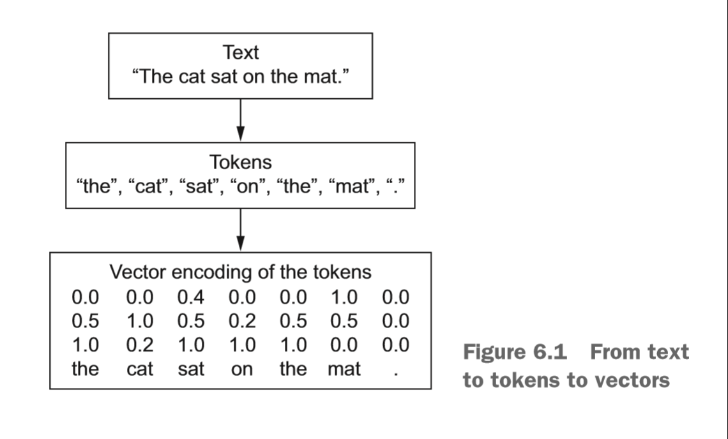
Text mapped to numerical vectors
First tokenize the text (and often remove punctuation , emoji, and other minor elements)
From the list of tokens create the encoded vector
Keras and many other NLP toolkits and frameworks provide utilities
Be consistent in use within a project – mixing may not always work out

Slide 29
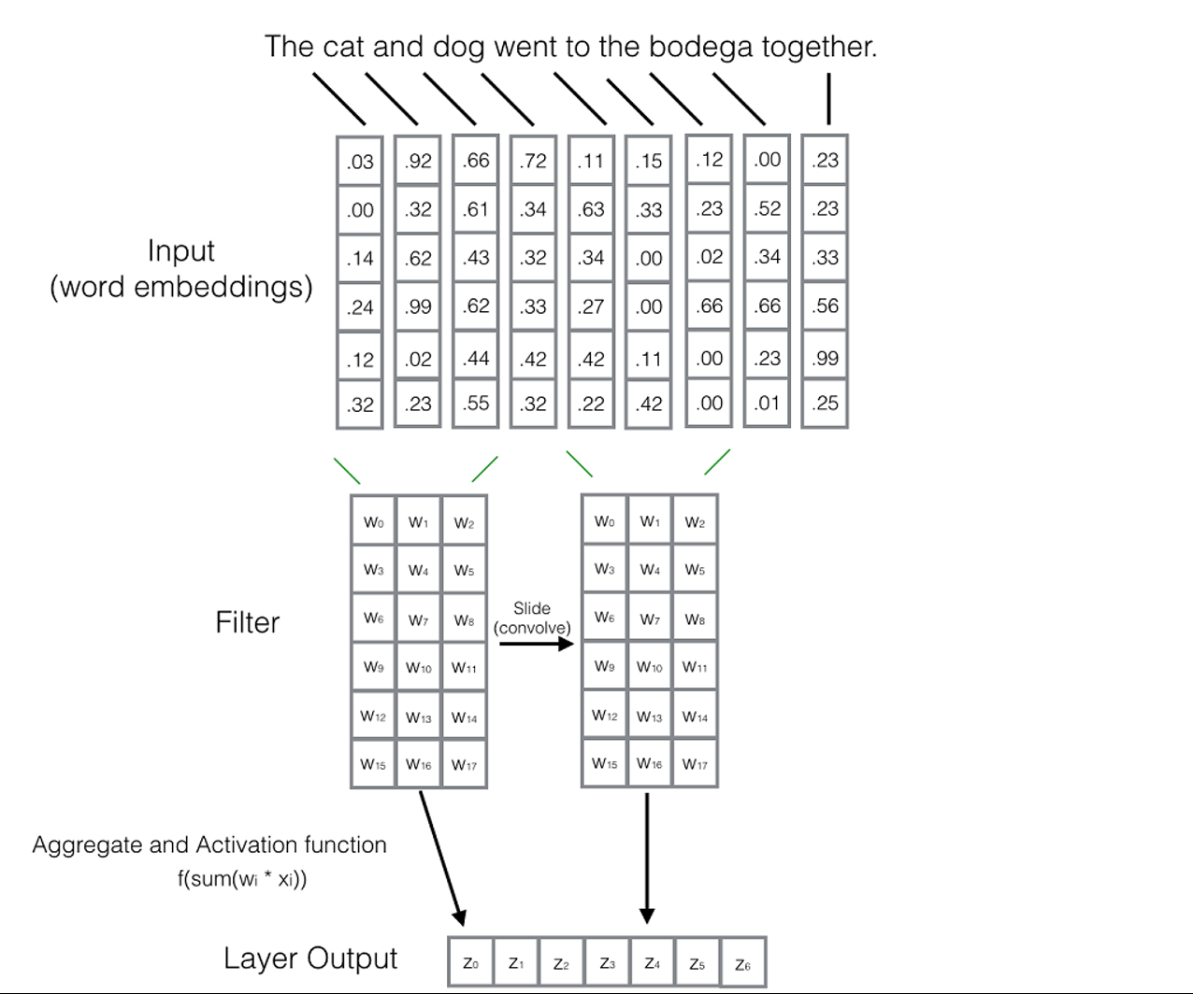
Embedding and filters
From Natural Language Processing in Action – Pub:Manning

Slide 30
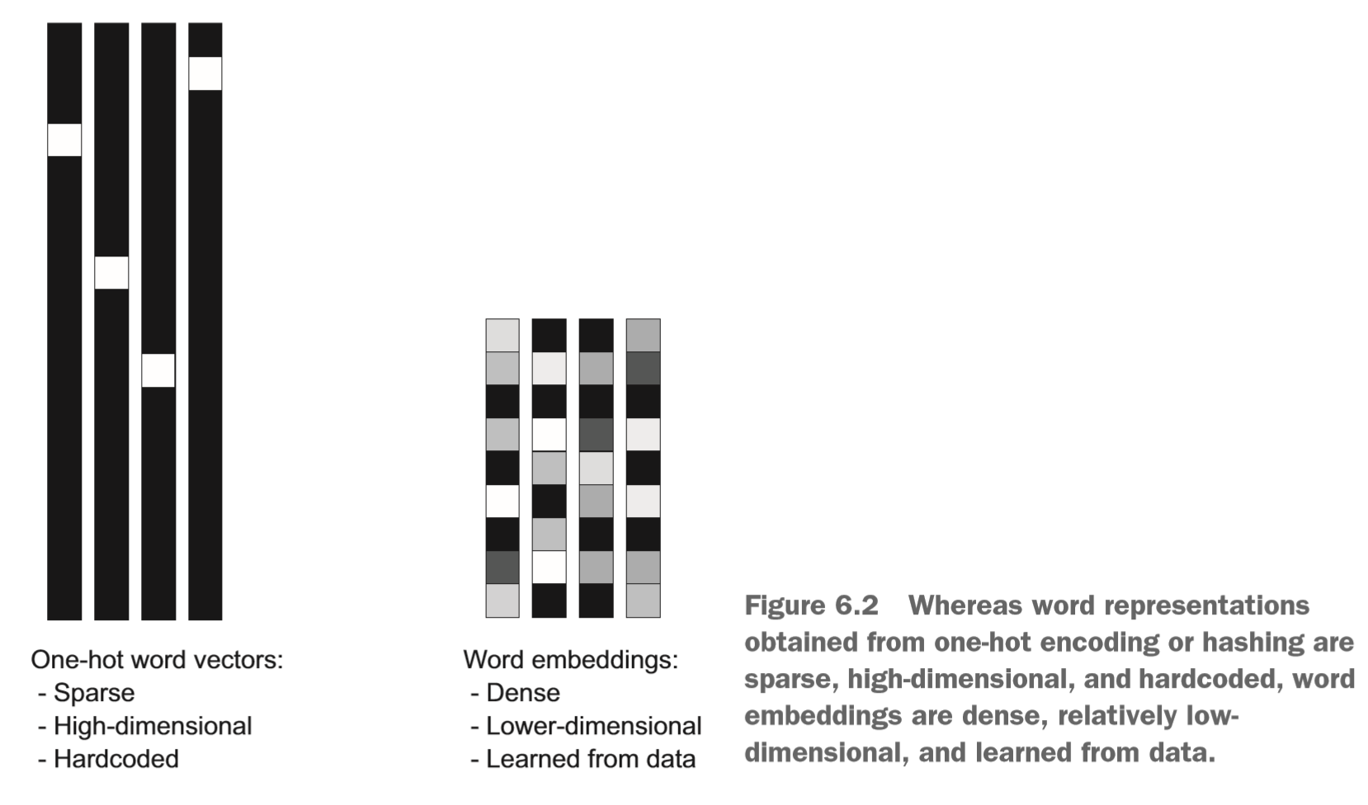
Word embeddings are efficient
Compare the empty spaces in a one hot encoded map (left side) and an embedded vector on the right.
The embedded vector also helps capture some co-locality of words and some of their context
This allows some richer operations with embedded word vectors
Several are available off the shelf
You can create an use your own with sufficient sample input

Slide 31
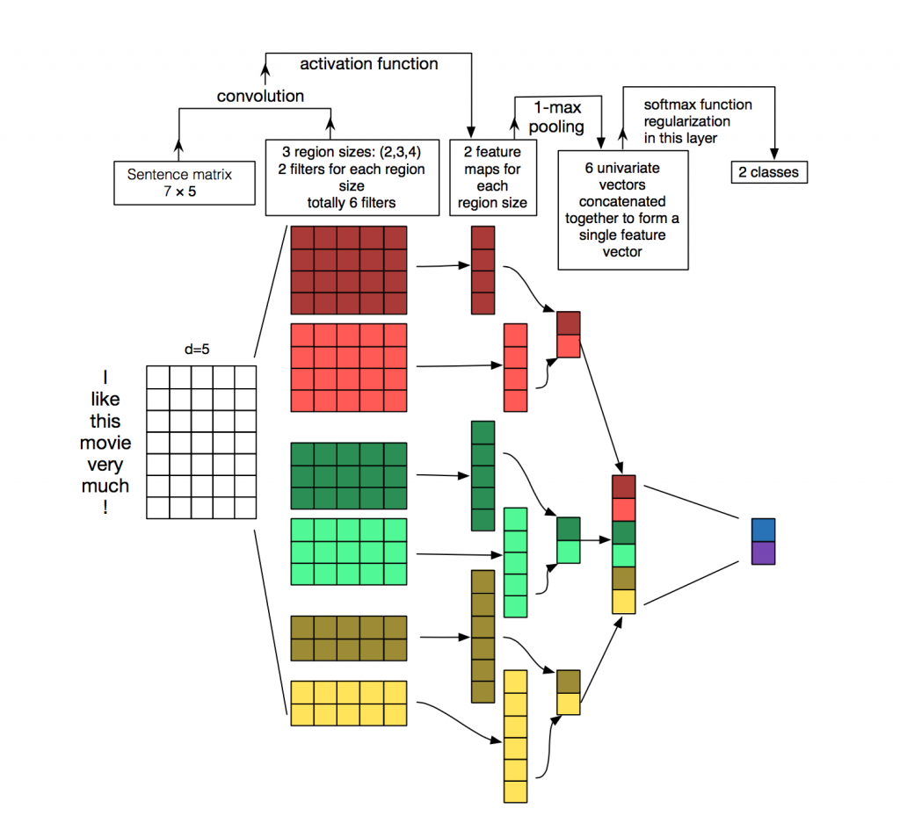
The big picture
We will break this down over the next few slides
http://www.wildml.com/2015/11/understanding-convolutional-neural-networks-for-nlp/

Slide 32
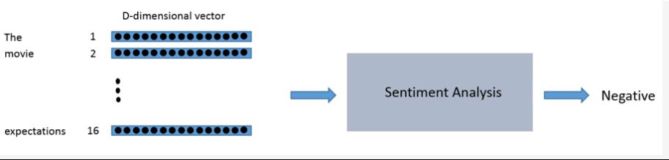
Basic flow of a sentiment scoring

Slide 33
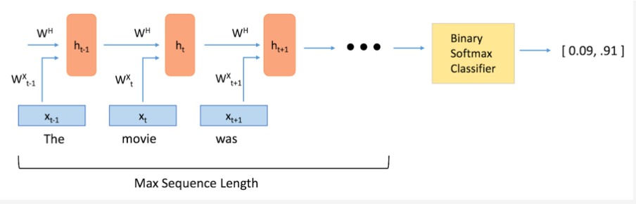
details
Notice max sequence length
Sentences vary in the number of tokens but many libraries expect a fixed size of input
Padding the input to a defined max value takes care of this
Notice a binary classifier using softmax to determine sentiment
Softmax is defined to scale to 1.0 so the sum of all items in softmax array will be 1.0

Slide 34
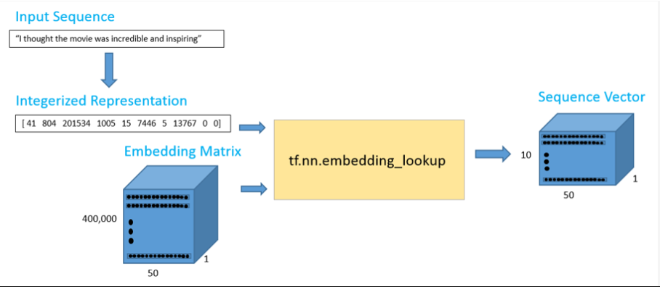
Even more detail
The sequence vector is the vectorized and padded inputs to the model – this is a simply case as it does not show the labels of training data where there might be another field representing the sentiment label (usually 0.0 or 1.0) for Good/Bad
https://github.com/adeshpande3/LSTM-Sentiment-Analysis

Slide 35
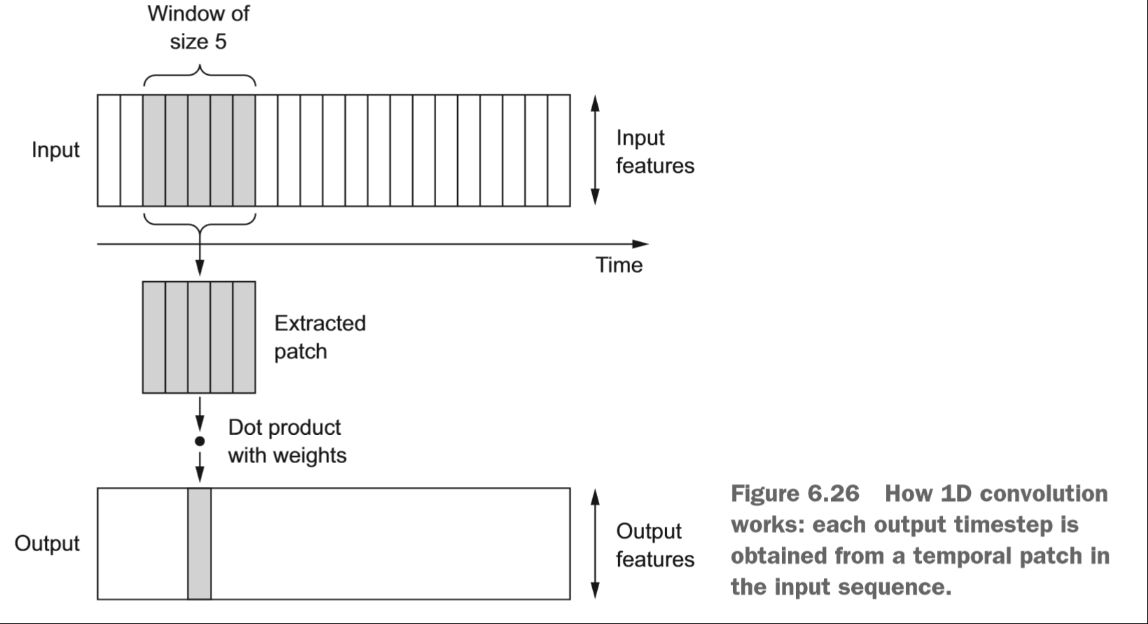
Treating sentences as sequences
Select size of window
Capture length of longest sentence (some frameworks handle this automatically)
Select number of filters
These are all inputs to the convolutional network architecture
These snapshots form a sequence over the text, in the order that the text is read.
This results in a set of weights for a sliding window over “time” – the order of the words or sentences.

Slide 36
Sample Code – jupyter notebook
convnets_text.ipynb
Posted to https://github.com/jimwill3/NY-AZML-Meetup/convnets_text.ipynb
This deck – same spot: Text-Analytics8-16-2018.pptx
Deck and code samples posted by Aug 21,2018

Slide 37
Resources
Concepts behind word2vec and word embedding
http://mccormickml.com/2016/04/19/word2vec-tutorial-the-skip-gram-model/
https://machinelearningmastery.com/develop-word-embeddings-python-gensim/
Books:
Natural_Language_Processing_in_Action – manning.com
Deep Learning with Python – also at manning.com
(recommend both for writing and good samples)

